Slide 1



11.B REVIEWING SYSLOG FILES
interpret events in relevant syslog files to
troubleshoot problems or review system status.

Slide 2

LOGGING EVENTS TO THE SYSTEM
Facility and priority

Slide 3

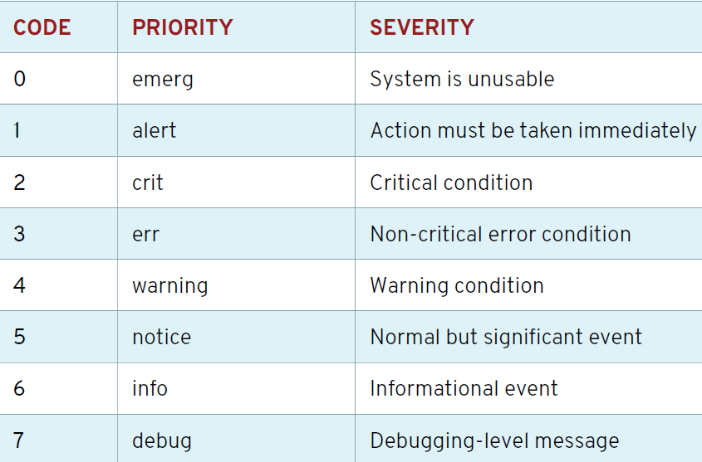
Syslog Priorities

Slide 4


rsyslog.conf
[user01@localhost ~]$ vim /etc/rsyslog.conf
[user01@localhost ~]$ vim /etc/rsyslog.d/app.conf
[user01@localhost ~]$ ssh user@127.0.0.1
[user01@remotehost ~]$ exit
[user01@localhost ~]$

Slide 5
log rotation
/var/log/messages-20210130 !!![

Slide 6
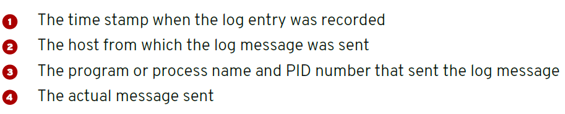
ANALYZING A SYSLOG ENTRY

Slide 7
MONITORING
[root@host ~]# tail -f /var/log/secure

Slide 8
SENDING SYSLOG MESSAGES MANUALLY
[root@host ~]# logger ”a default log message”
[root@host ~]# logger -p local7.notice "Log entry\ created on host"

